Slide 1
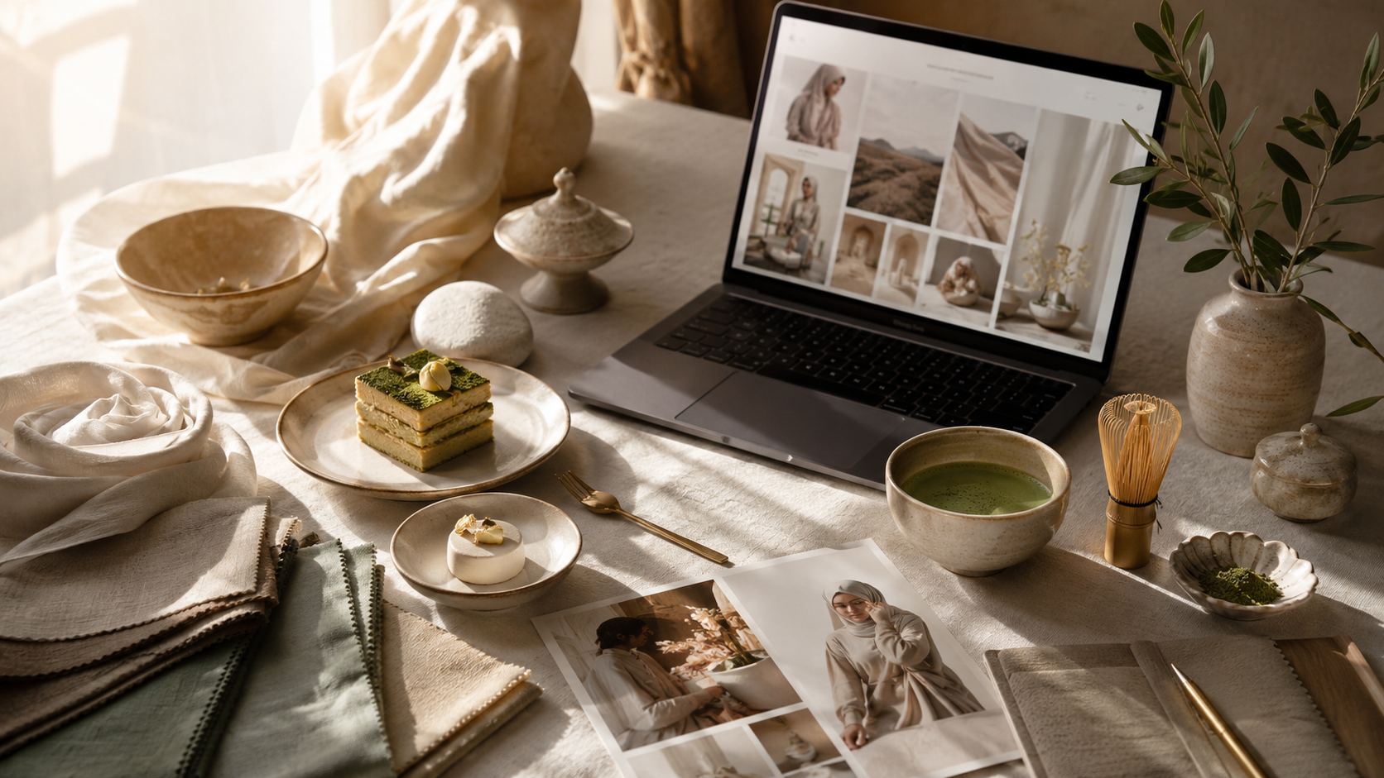
ARAHKAII
PARTNERSHIP PACKAGE
Editorial Brand Marketing
for Values-Led Luxury Brands
Brand strategy • storytelling • design production • social systems • partnership campaigns
Living beautifully, with intention.

Slide 2

EXECUTIVE SUMMARY
A premium media + brand studio built for intentional growth
Arahkaii helps aligned brands become more discoverable, more desirable and more consistent across every customer touchpoint — without relying on generic content or noisy advertising.
What clients buy
What clients feel
What clients get
A professional brand system, editorial narrative, social templates, partnership content and performance-ready campaign assets.
Clarity, confidence and a premium positioning they can use everywhere: website, social, pitch decks, newsletters and campaigns.
A ready-to-use design production kit plus a distribution plan built around editorial trust and values-aligned storytelling.
ARAHKAII
02

Slide 3
POSITIONING
Where Arahkaii sits in the market
01
02
Tatler-style prestige
CNA-style utility
Arahkaii bridges the gap between premium editorial media and practical brand marketing. We make brand strategy feel like culture — and make content consistent enough to scale.
People, fashion, culture, refinement
Local relevance, useful guides, service content
03
04
Muslim-conscious lens
Client-ready system
Values-led curation without alcohol or nightlife
Templates, pitch assets, posts, reporting
ARAHKAII
03

Slide 4
VALUES-LED CURATION
Premium lifestyle without compromising the brand standard
Our editorial system is aspirational, modern and inclusive — while protecting Arahkaii’s Muslim-conscious positioning.
WE AMPLIFY
WE AVOID
Halal / Muslim-friendly dining
Bars, beer, wine, cocktails
Desserts, cafes, tea, matcha
Nightclubs or party-first lifestyle
Modest luxury & Asian designers
Gossip, scandal and clickbait
Evening experiences without party framing
Over-sexualised fashion imagery
Beauty, wellness and city guides
Generic luxury without purpose
This makes Arahkaii attractive to values-aligned clients seeking a premium audience without brand-risk adjacency.
ARAHKAII
04

Slide 5
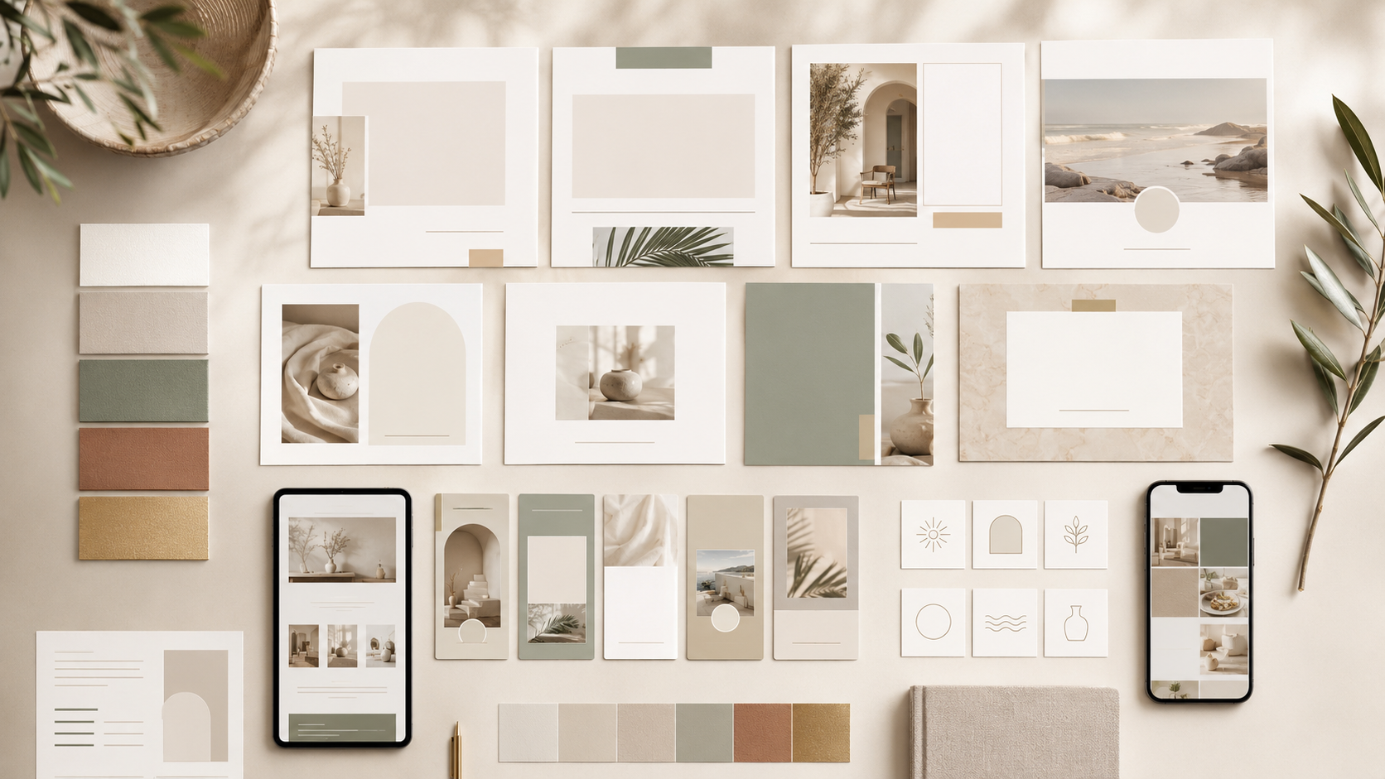
DESIGN PRODUCTION KIT
Everything a client needs to stay consistent
A complete system of assets, templates and rules that turns strategy into a repeatable content machine.
Logo suite
Colour styles
Typography rules
Main logo, monogram, editorial stamp
Ivory, oat, date brown, sage, soft gold
Serif headlines + clean sans body system
Photo direction
Social templates
Partner assets
Warm, editorial, calm, culturally aware
10 fixed Canva/Figma formats
Media kit, pitch deck, campaign one-pagers
ARAHKAII
05

Slide 6
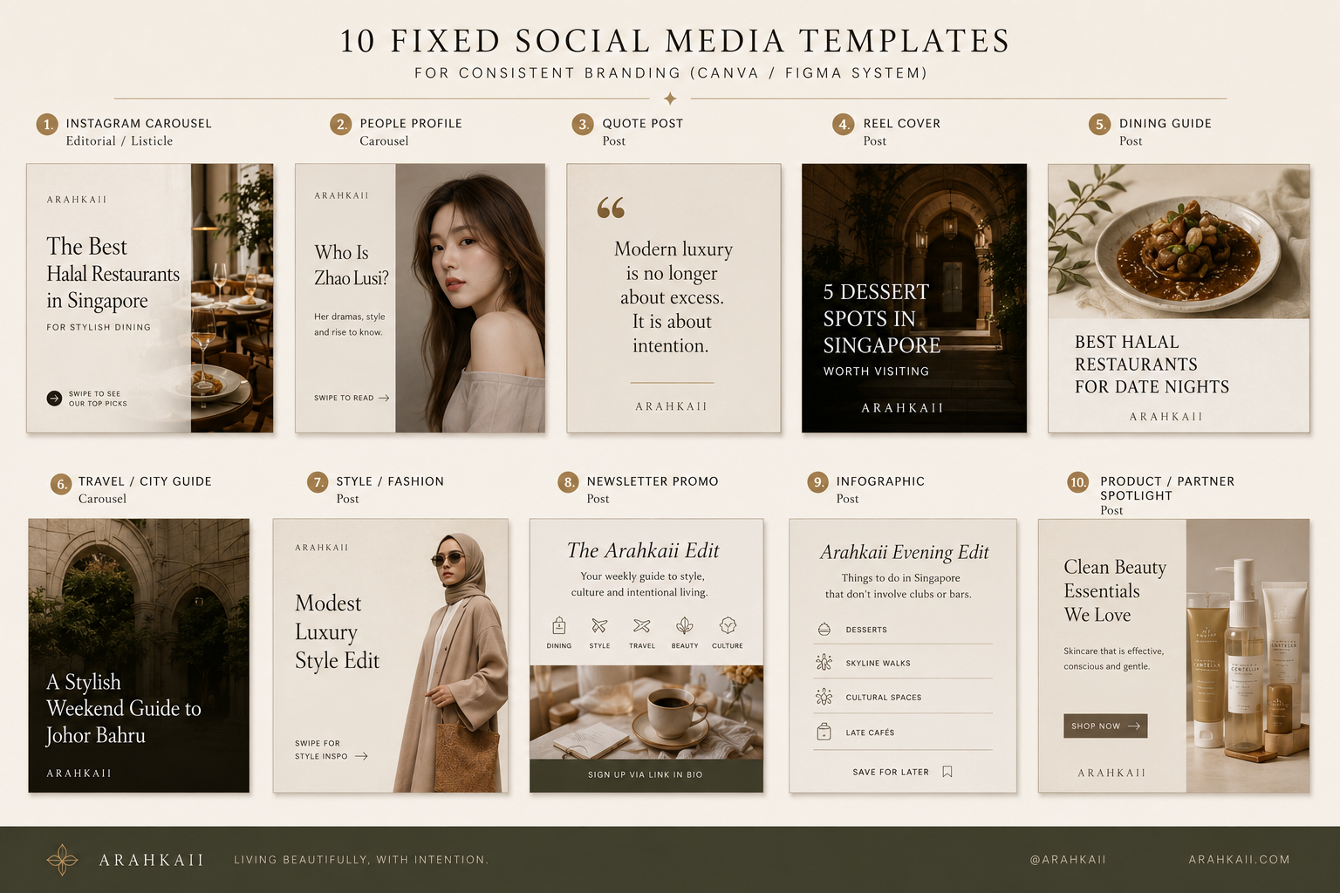
TEMPLATE SYSTEM
10 fixed Canva/Figma templates — no more designing from scratch
The goal is speed and consistency: every post starts from a proven editorial layout, then adapts content, imagery and headline only.
1
Editorial Carousel
6
Travel / City Guide
2
People Profile
7
Style / Fashion
3
Quote Post
8
Newsletter Promo
4
Reel Cover
9
Infographic
5
Dining Guide
10
Product Spotlight
ARAHKAII
06

Slide 7
TEMPLATE PLAYBOOK
Which template to use, when
Template
Use case
Distribution
Editorial Carousel
Guides, explainers, listicles
IG carousel, LinkedIn PDF, Pinterest
People Profile
Founder, designer, actor profiles
IG carousel, article lead, newsletter
Dining Guide
Halal, cafe, dessert and evening guides
IG carousel, article, Google Discover
Reel Cover
Short-form video series
Reels, TikTok, Shorts
Newsletter Promo
Subscriber acquisition
Instagram, site popups, email
Partner Spotlight
Client campaign or product feature
Social, pitch deck, paid boost
Result: faster output, tighter brand memory, cleaner client approvals and a premium look across all channels.
ARAHKAII
07

Slide 8
PARTNERSHIP PACKAGE
Three ways to partner with Arahkaii
Packages can be sold as editorial media placement, brand strategy services, or a hybrid campaign that gives the client assets and audience reach.
The Feature
The Campaign
The Partnership
ONE-OFF EDITORIAL STORY
QUARTERLY GROWTH PACKAGE
ALWAYS-ON BRAND PLATFORM
Brand interview, feature article, social rollout, newsletter placement, SEO optimisation
3 features, 10 social assets, landing page, newsletter placements, monthly reporting
Dedicated content calendar, templates, features, social, newsletter, performance review
From $4,800
From $9,500
Custom
ARAHKAII
08

Slide 9
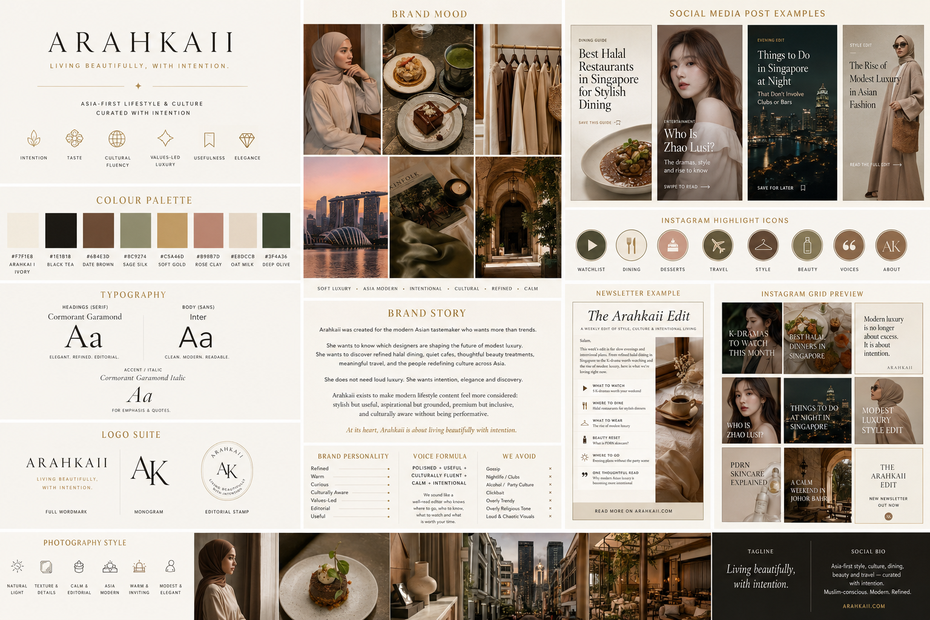
CLIENT DELIVERABLES
A complete campaign ecosystem
The partnership is not a single post. It is a system that gives clients strategy, story, assets, distribution and reporting.
Brand Strategy
Design Production Kit
Positioning, audience, voice, messaging angle
Logo use, colour, typography, templates, image rules
Editorial Feature
Social System
Long-form story, interview, SEO article, conversion links
10 fixed templates, captions, reel covers, carousel layouts
Newsletter Placement
Reporting
Curated send to aligned readers with campaign CTA
Performance summary, traffic, engagement, recommended next steps
ARAHKAII
09

Slide 10
IDEAL PARTNERS
Brands that fit the Arahkaii audience
Hospitality
Dining & Dessert
Boutique hotels, resorts, Muslim-friendly stays
Halal restaurants, cafes, patisseries, tea, matcha
The best-fit clients are premium, thoughtful and values-aligned. They want trust, not just impressions.
Fashion
Beauty & Wellness
Modest luxury, Asian designers, occasionwear
Facials, scalp treatments, clean beauty, spas
Travel & City
Home & Living
JB, KL, Bali, Bangkok, Penang guides
Ceramics, interiors, hosting, thoughtful gifting
Partnership filter: premium enough • useful to readers • values-aligned • no alcohol/nightlife/gambling/adult adjacency.
ARAHKAII
10

Slide 11
HOW WE WORK
A four-stage editorial campaign workflow
Simple enough for clients to understand. Structured enough for your team to execute repeatedly.
01
02
03
04
Discover
Define
Create
Amplify
Brand audit, audience, values filter, offer clarity
Campaign angle, editorial story, content calendar
Photography direction, copy, templates, social assets
Publish, newsletter, social rollout, reporting
ARAHKAII
11

Slide 12
PERFORMANCE REPORTING
Premium storytelling with measurable outcomes
3
10
1
EDITORIAL ASSETS
SOCIAL ASSETS
NEWSLETTER SEND
Every partnership should end with a simple report: what was published, how it performed, and what the next growth opportunity is.
Organic sessions
Search impressions
Newsletter clicks
Social saves/shares
Lead enquiries
Conversion actions
Client-facing dashboard
Clear enough for founders, detailed enough for marketing teams.
ARAHKAII
12

Slide 13
SETUP RECOMMENDATIONS
What to add to the current partner page
Audience proof
Values policy
Current reach, subscriber count, reader profile, geography
Clear halal/Muslim-conscious partnership boundaries
The uploaded HTML concept already has a polished editorial studio feel. These additions make it more conversion-ready for potential partners.
Case study format
Package comparison
Problem, story, assets created, results, testimonial
Feature vs Campaign vs Partnership, with deliverables
Booking path
Media kit download
Discovery call CTA, short enquiry form, calendar link
PDF deck, rate card, template examples, brand rules
Next build priority: turn the partnership page into a conversion hub with proof, packages, clear fit, and a booked-call CTA.
ARAHKAII
13

Slide 14
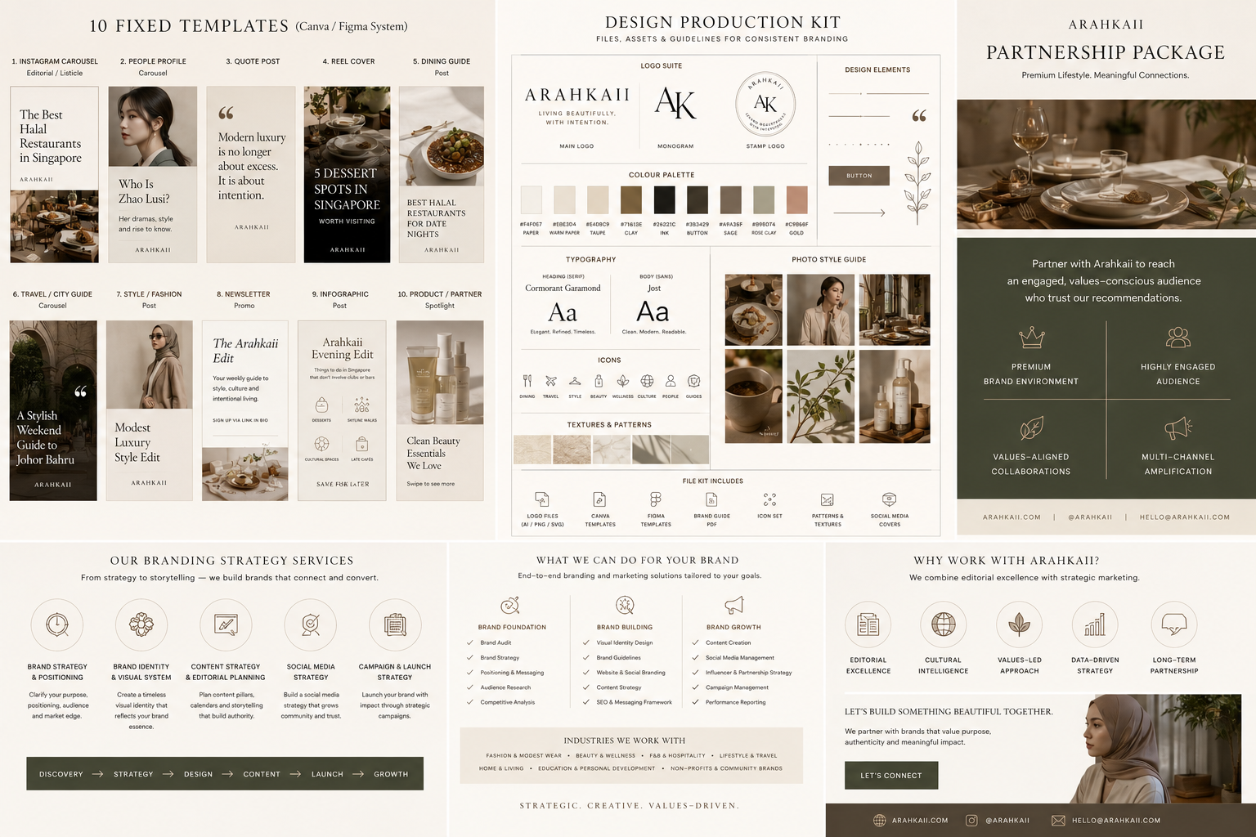
PRODUCTION KIT
Files to create once, then reuse every week
Logo pack: PNG, SVG, black, ivory, monogram, stamp
Colour styles: HEX codes and usage rules
Typography styles: H1/H2/body/caption/social headline
10 Canva/Figma templates with locked guides
Reel cover system and thumbnail rules
Newsletter template and header graphics
Partner feature one-pager and media kit PDF
Campaign report template and metrics dashboard
This is the operational layer that keeps the brand consistent even when multiple people are producing content.
ARAHKAII
14

Slide 15
ARAHKAII
Let’s build something beautiful together.
Recommended next step: send this deck with a short email, then direct potential partners to a 20-minute discovery call.
CONFIRM PACKAGE PRICING
ADD AUDIENCE PROOF
EXPORT PDF MEDIA KIT
PUBLISH PARTNERSHIP LANDING PAGE
partnerships@arahkaii.com • arahkaii.com • @arahkaii

